Slide 1
Plant-Animal Relationships

Slide 2
Herbivores
Grazers – eat grasses and pasture plants.
Sheeps and cows
Browsers – eat leaves of trees and shrubs.
Giraffes
Sap-suckers – pierce the leaf or stem and suck the sap in the phloem.
Vine hoppers and aphids

Slide 3
Herbivores
Nectar feeders – drink the nectar in flowers.
butterflies
Stem borers – drill holes in wood, eating it as they go.
Borer beetles, citrus tree moth larva
Chewers – chew roots underground.
Cicada nymphs, NZ grass grub larva
Pollen feeders – eat pollen from flowers.
Bees, birds

Slide 4
Herbivores
Fruit and seed eaters.
Humans, birds, rats, squirrels etc
Gum eaters – scratch the bark and lap up the gum as it runs out.
marmosets

Slide 5
Co-operative Relationships
Pollination
Animal pollinators are attracted to flowers by reward and advertisement.
The reward is located in such a way that the animal cannot get it without also being covered in pollen.
Some orchids have petal markings that look like a wasp so that the male wasp will copulate with the flower, thus getting covered with the orchids pollen.

Slide 6
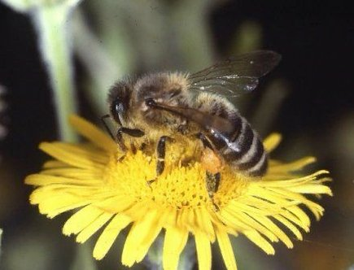
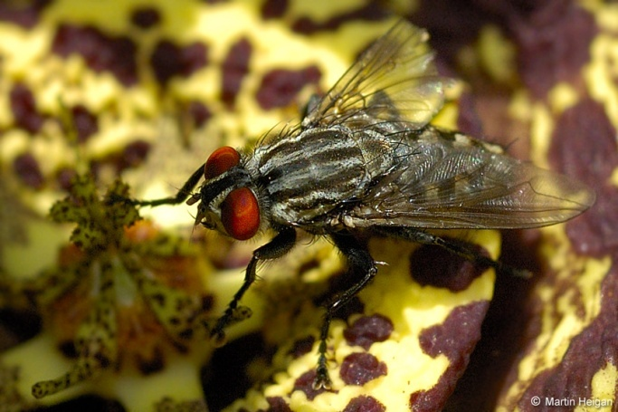
Co-operative Relationships
Pollination cont
Flowers that are pollinated by bees and insects tend to be coloured ultra-violet, blue and yellow.
Red flowers are either heavily perfumed, have some blue or ultra-violet in the red, or are pollinated by birds, fireflies or butterflies who see red very well.

Slide 7
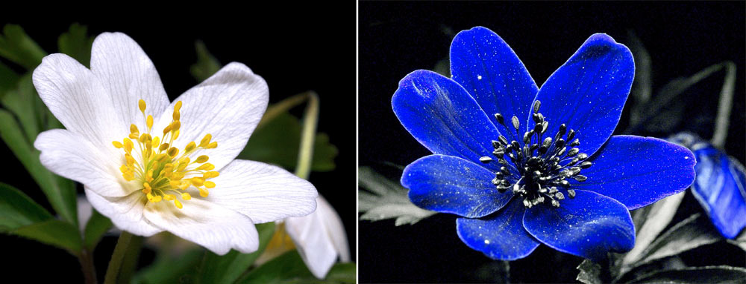
Pollination

Slide 8
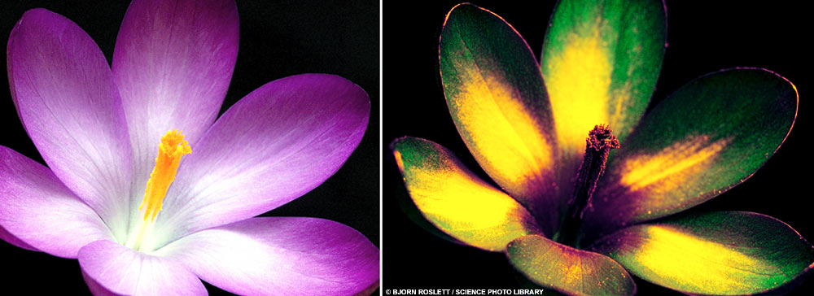
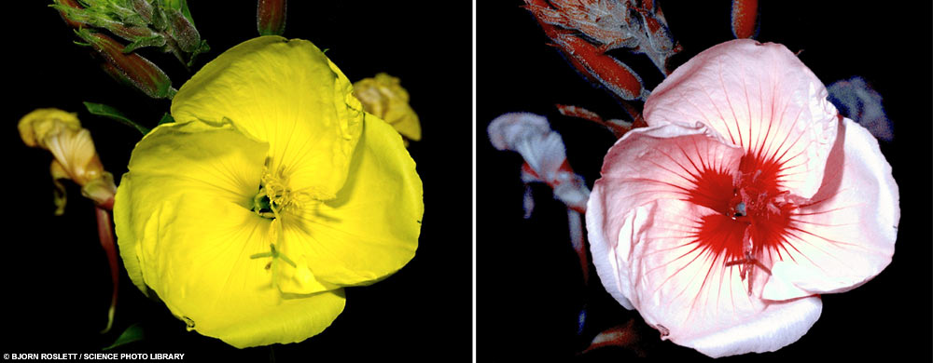
Pollination

Slide 9
Co-operative Relationships
Some stinging ant colonies will guard a tree, attacking insects and browsers, and will even chew through seedlings that attempt to grow near their tree.
Some animals get protection by living amongst the thorns
Birds nesting in cacti

Slide 10
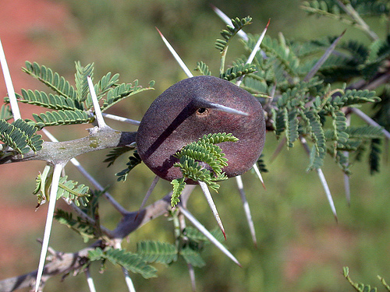
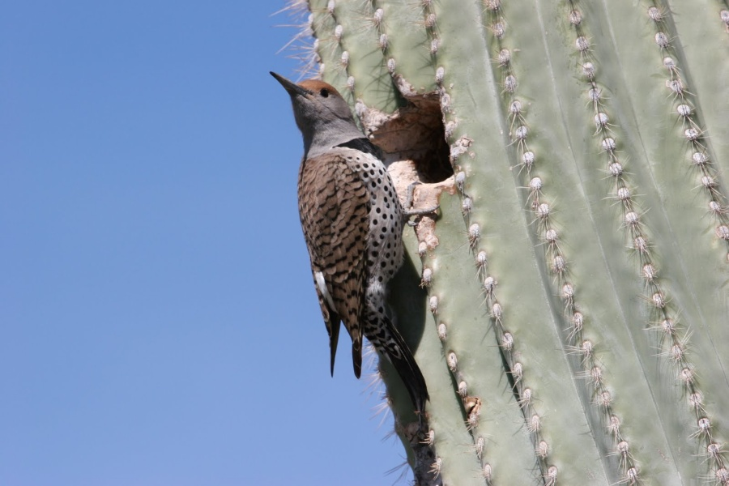
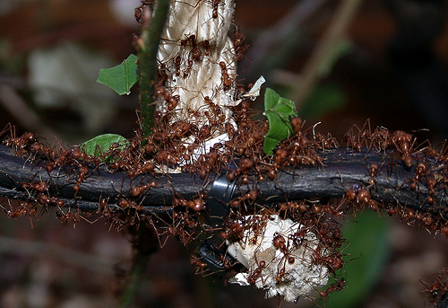
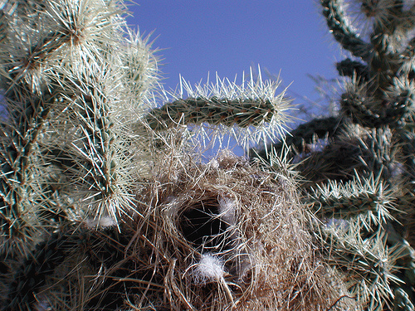

Slide 11
Co-operative Relationships
Many seeds have small hooks that catch on animals’ fur or feathers, so they are carried away from the parent plant.
Birds eat juicy fruit, the seeds of which pass through their digestive system and are deposited far away from the parent tree, complete with fertiliser.
Some seeds contain a powerful laxative to help this process along.

Slide 12
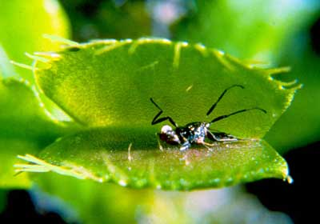
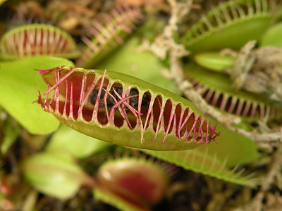
Plants that Eat Animals
These trap and digest insects to get the nitrogen out of their bodies.
These plants usually live in areas with no humus or a low oxygen content.
E.g. venus fly trap, pitcher plant and sundew.

Slide 13
