Slide 1
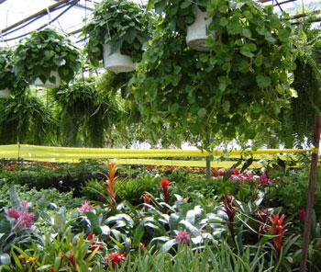
Plant Defence Systems

Slide 2
Plant Defence Systems
Plants are sessile, i.e. they can’t move from place to place.
They need some defences against herbivores that might want to eat them, and against pathogens.
Plants counter these by both physical and chemical defences.

Slide 3
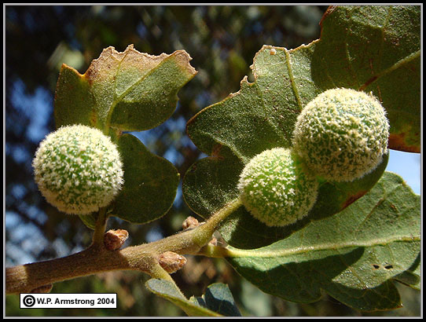
Physical Plant Defences

Slide 4
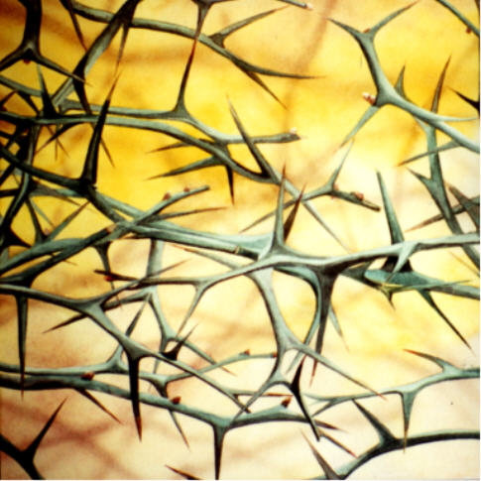
Thorns
These are modified branches, usually formed from the axil of the leaf, e.g. a hawthorn.

Slide 5
Spines
These are modified leaves, e.g. found in gooseberry.
In an extreme case, the cactus, all the leaves are turned into spines and photosynthesis is taken over by the stem.
Sometimes the spines are kept to the outside of the leaf. E.g. holly

Slide 6
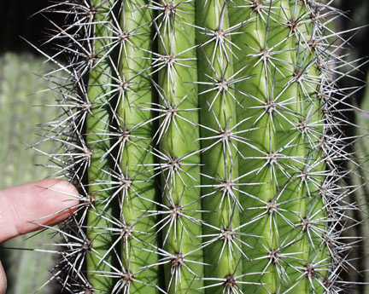
Spines
In holly we find that the leaves near the bottom of the tree, within reach of the browsers, have the most spines – those at the top of the tree have almost completely lost them.

Slide 7
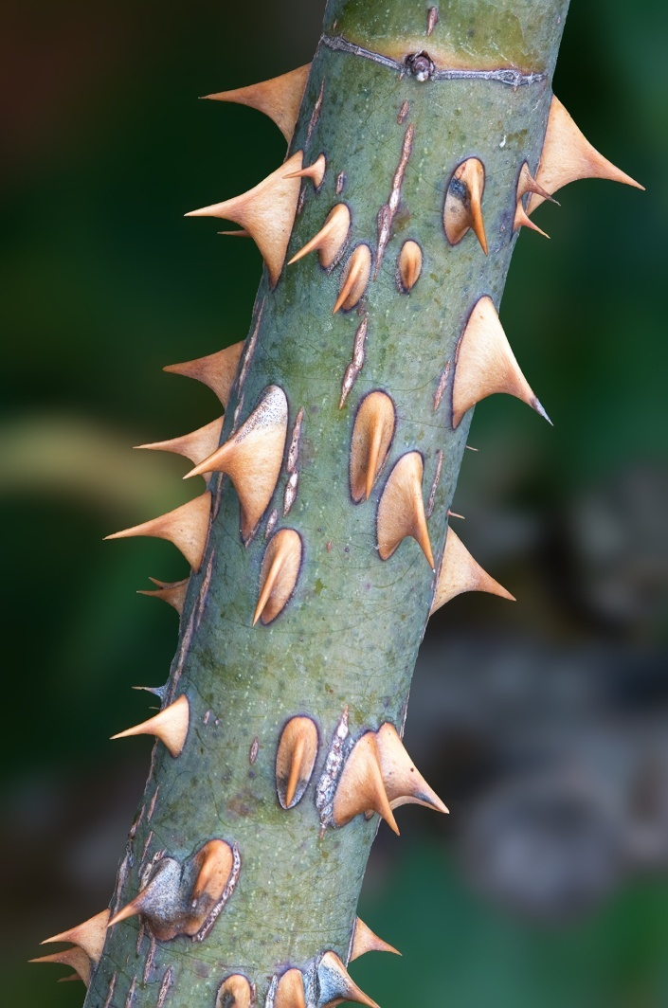
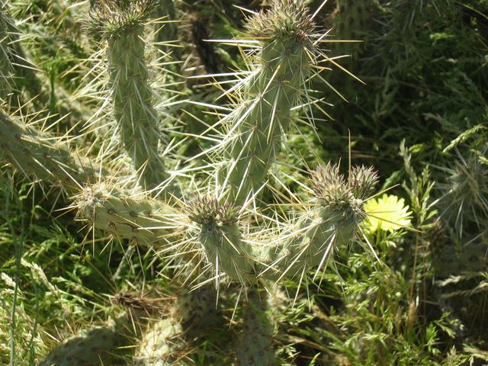
Prickles
These are outgrowths of the superficial tissue of the stem.
E.g. roses and blackberry

Slide 8
Stings
These are modified hairs, found on plants such as the stinging nettle.
The hair has a rounded base containing secretory cells that make an irritating fluid containing histamine and acetyl choline.
The top of the hair ends in a small rounded tip that breaks off when touched by an animal’s skin and the fluid is injected.

Slide 9
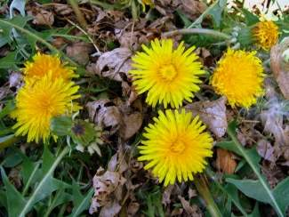
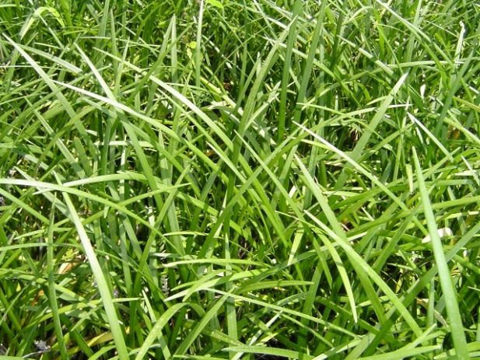
Low Growing Points
Many plants can tolerate being grazed by having their growing points very low on the ground where the herbivores can’t eat it.
This means the plant is able to keep on growing.
E.g. grasses and dandelions.

Slide 10
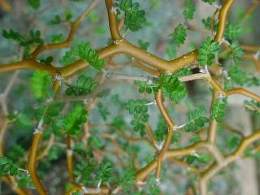
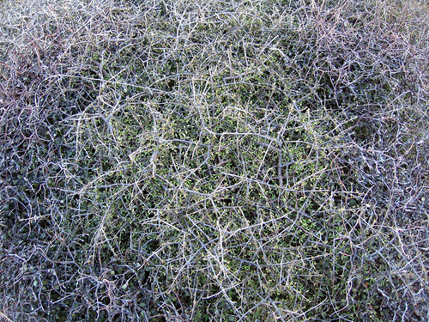
Divarication
These plants branch at wide angles with closely interlaced branches, forming a tangled mass.
Often the outer branches have smaller, fewer leaves than the inner branches, which are protected from the browsers.

Slide 11
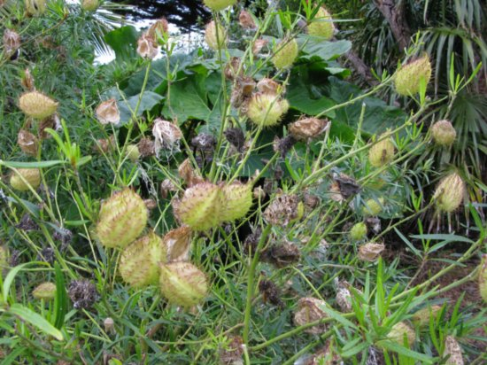
Enclosing Seeds in a Hard Coat or Prickles
This is a good and obvious way to deter predators.
E.g. Swan plants

Slide 12
Seed Masting
This is the simultaneous release of all the seeds by all the trees of the same species in an area, at intervals of 2 years or more.
The advantage is that most of the time there are not enough seeds to support a large population of seed-eating animals.
When the seeds are shed, the animals present can’t possibly eat them all so a large number of seeds survive.

Slide 13
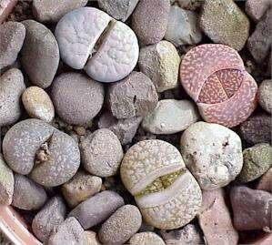
Hiding
There are some plants, found in Southern Africa, called Stone Plants, that are the colour and shape of the stones amongst which they grow.
Thus they are completely camouflaged until they flower.

Slide 14
Waxy Cuticle and Epidermis
The main barrier against the invasion of pathogens is the leaf epidermis.
Viruses and other pathogens can only enter through a break in it or through the stomata.
The worst vectors of pathogens are sap-sucking animals which pierce the epidermis and insert their proboscis into the sap.

Slide 15
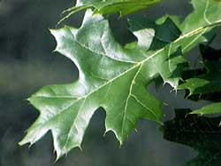
Waxy Cuticle and Epidermis
They then fly to another leaf, carrying with them viruses, fungal spores and bacteria.
E.g. aphids, passionfruit vine hoppers and green shield bugs

Slide 16
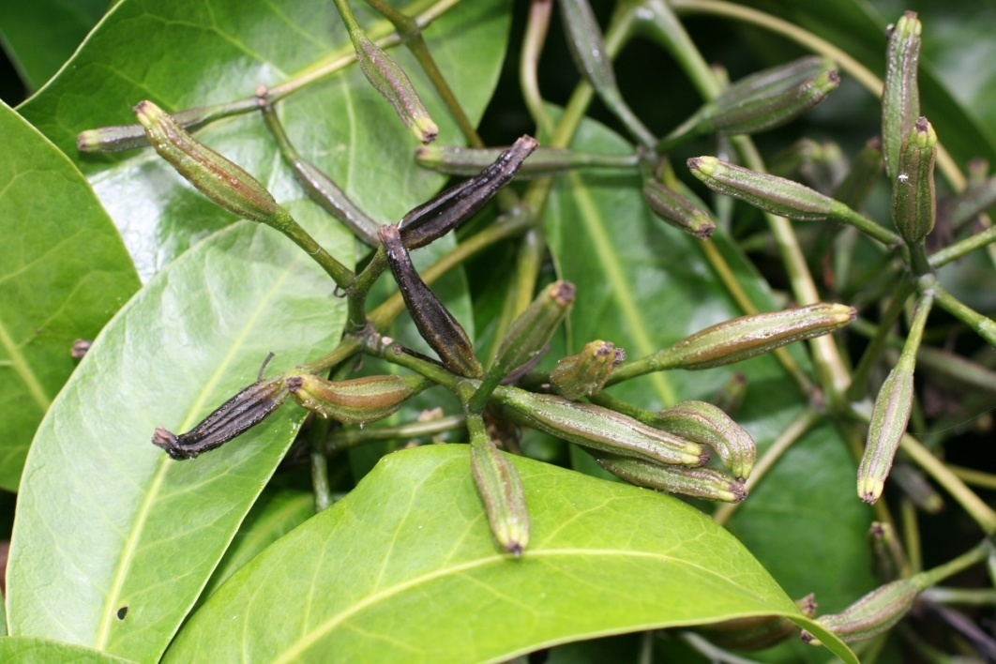
Trapping
Some chemicals are sticky, and would-be eaters.
The Parapara has sticky seeds that can entrap small birds so they cannot fly.

Slide 17
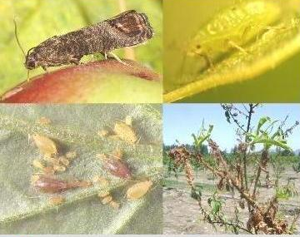
Chemical Defences

Slide 18
Chemical Defences
Plants produce some extremely toxic substances, yet they themselves are not poisoned by these chemicals.
It has been established that these chemicals are kept in vacuoles and are only released when the leaf is chewed or pierced.

Slide 19
Chemicals Used Against Pathogens
Antibiotics
once a pathogen invades a plant, it sets up a chemical attack.
the infected plant starts to produce chemicals called Phytoalexins.
These are antibiotics which kill or inhibit the pathogens

Slide 20
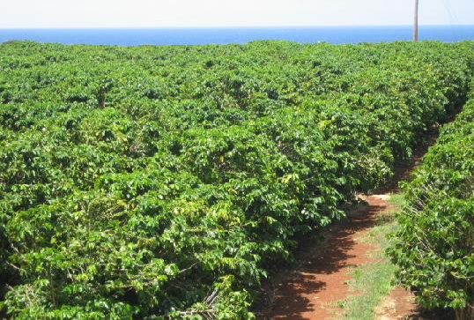
Chemicals Used Against Pathogens
Caffeine
This is the main stimulant in coffee, tea and in some painkillers.
This is extracted from the coffee tree beans.
In the plant, it has a physiological effect on fungi.

Slide 21
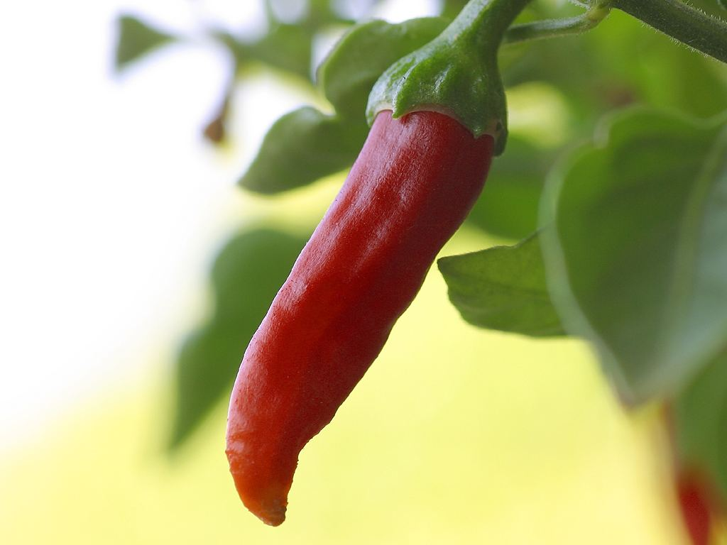
Chemicals Used Against Pathogens
Chillies
Very good antibiotics
Have a “hot” taste to put off mammals

Slide 22
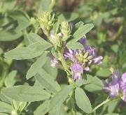
Common Chemicals that Deter Insects
Canavanine
This is a defence against chewing insects.
It is an amino acid which resembles arginine.
When the insect eats it the Canavanine becomes incorporated into the insects proteins instead of arginine and the insect dies.

Slide 23
Common Chemicals that Deter Insects
Cyanogenesis
This is the production of cyanide.
In the wild cherry, some grasses and some varieties of white clover.
When tissues of these plants are damaged by insects or snails, a non-poisonous glycoside is changed by an enzyme to the poisonous hydrogen cyanide.
Some animals produce enzymes that convert this poison to harmless thiocyanate.

Slide 24
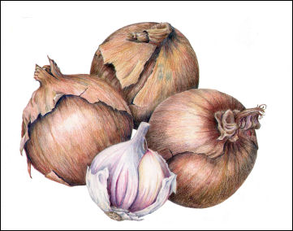
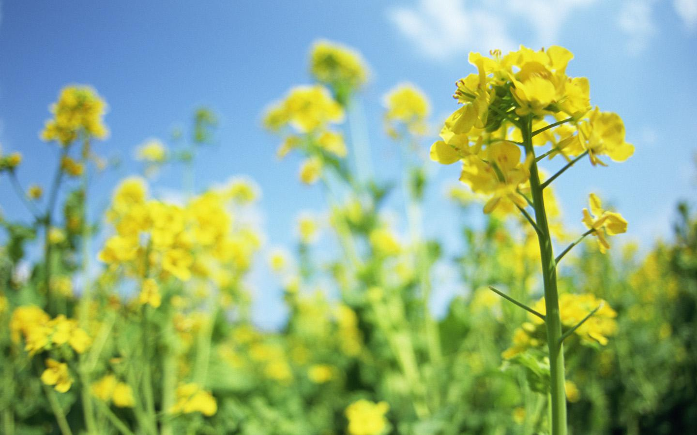
Common Chemicals that Deter Insects
Pungent and Volatile Chemicals
The smells given off by onions, garlic and mustards are thought to stop insects from even landing on the plants.

Slide 25
Common Chemicals that Deter Insects
Pyrethrins
Some chrysanthemums produce a chemical in their leaves that is very poisonous to insects, preventing them from eating the leaves.
The caterpillars of certain moths and butterflies have developed an enzyme have developed an enzyme that can detoxify the pyrethrin, and these can eat the leaves unharmed.

Slide 26
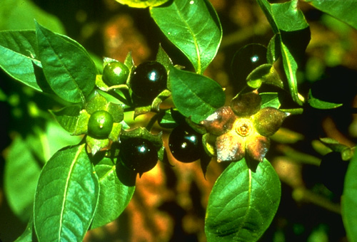
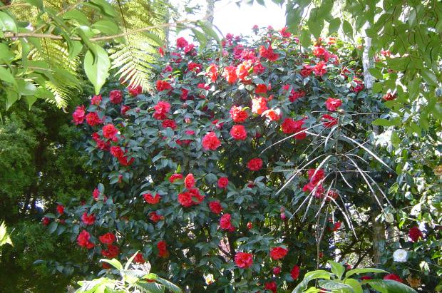
Common Chemicals that Deter Insects
Tannins
In oak leaves and camellia act to stop insects eating their leaves.
Alkaloids
These are bitter tasting, thus prevent insects from eating them. Found in the Deadly Nightshade.

Slide 27
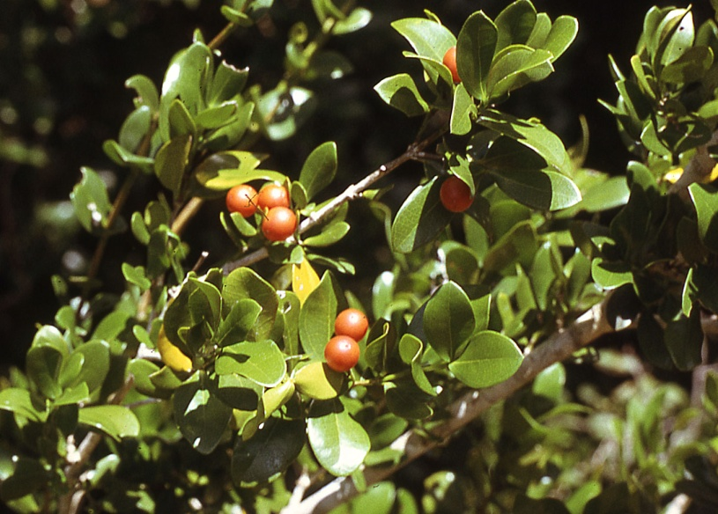
Common Chemicals that Deter Insects
Phenols
These are also thought to deter insects. They are very good germicides – used in hospitals.
Strychnine
This is produced by plants of the strychnos family

Slide 28
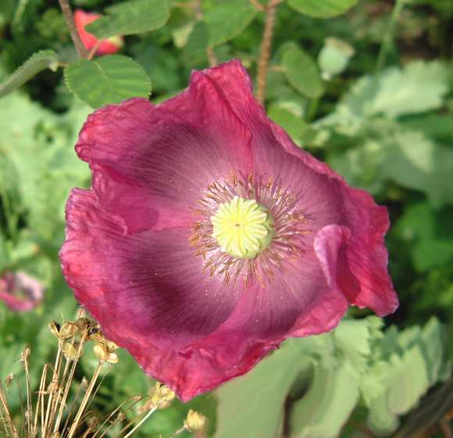
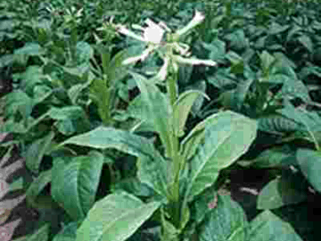
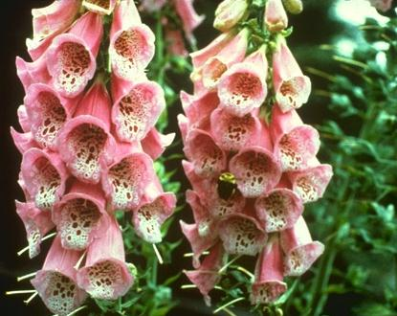
Common Chemicals that Deter Insects
Morphine
This comes from the opium poppy.
Nicotine
This is produced in the tobacco plant
Digitoxin
This is made in the common foxglove.

Slide 29
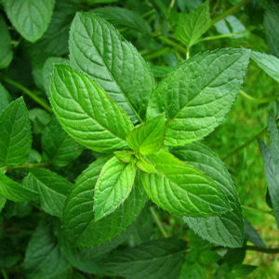
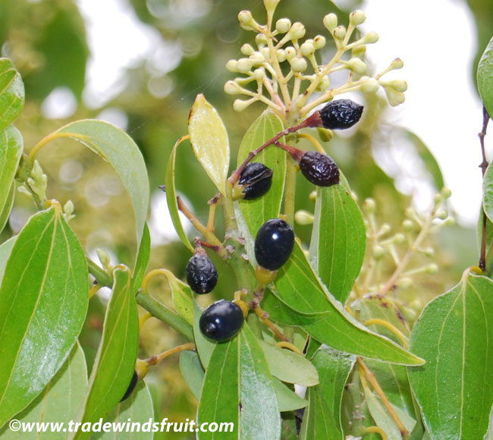
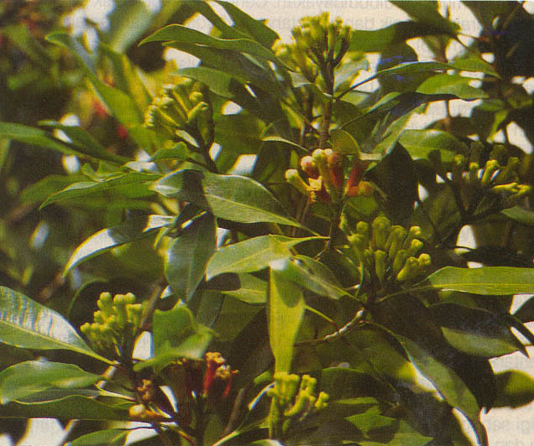
Common Chemicals that Deter Insects
Others
Some secondary compounds that are not poisonous to humans but may put off insects.
E.g. peppermint, cinnamon and cloves.

Slide 30
Poisons Incorporated into the Body of Insects
These can deter the predators of caterpillars.
E.g. the Monarch butterfly caterpillars have become tolerant of the poisons in the swan plant. As they eat these poisons accumulate and make the caterpillars’ own tissues unpleasant for a bird to eat.

Slide 31
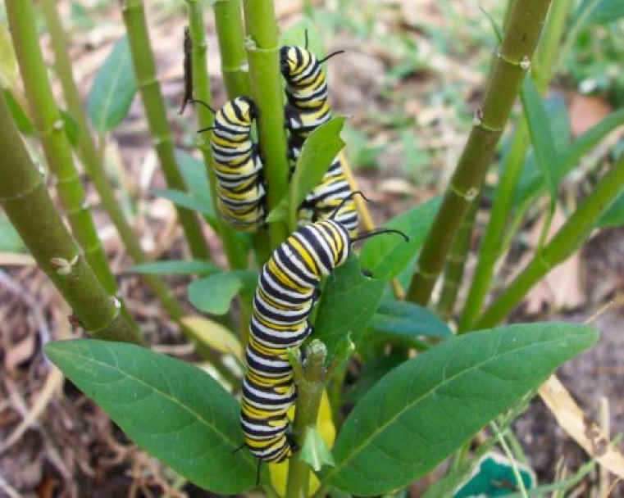
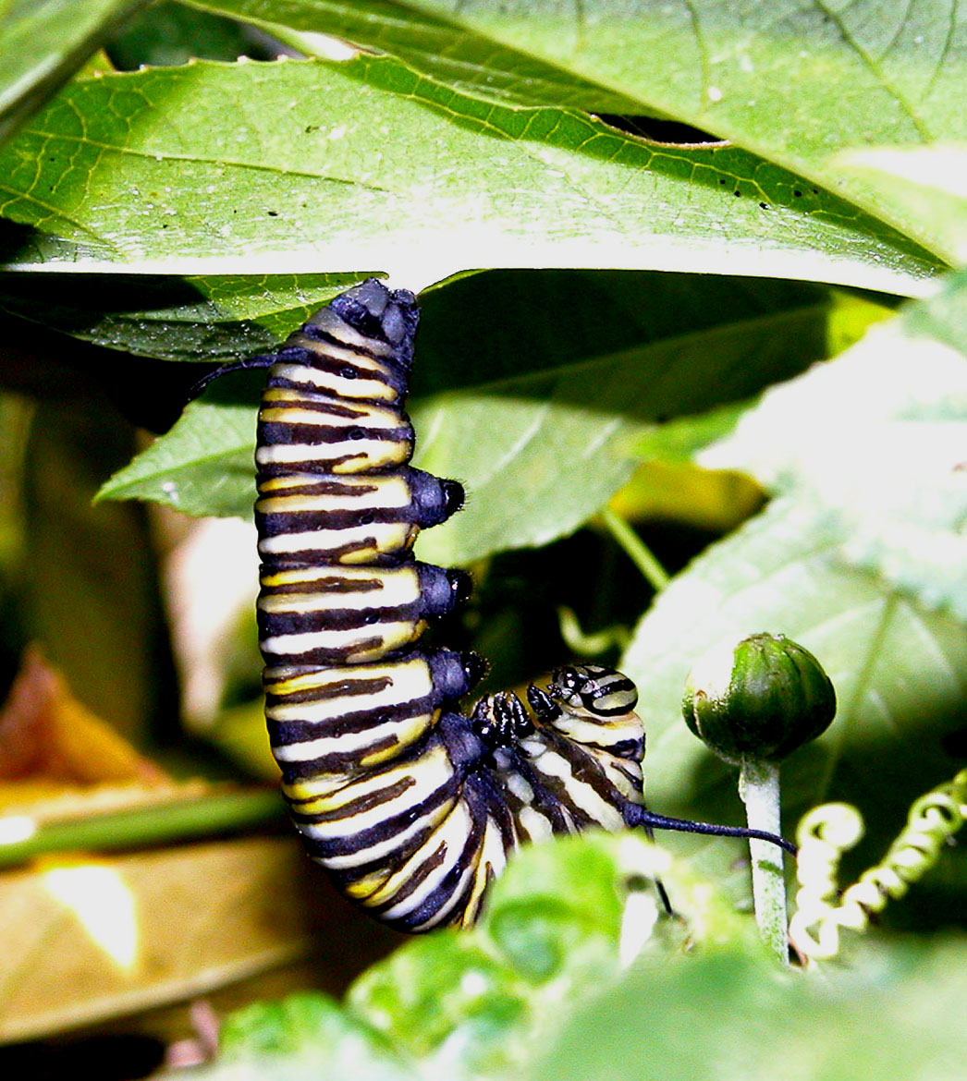
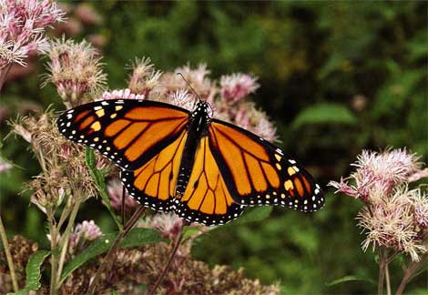

Slide 32
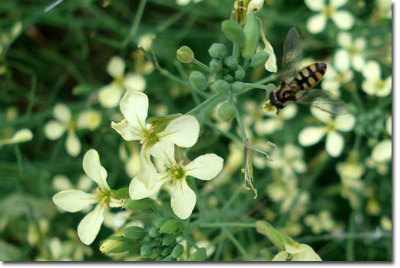
Chemical Mimics
Tropical Sedge makes a chemical like the juvenile growth hormone of insects.
If the insects eat the plant they turn into deformed adults with twisted wings and unformed ovaries.

Slide 33
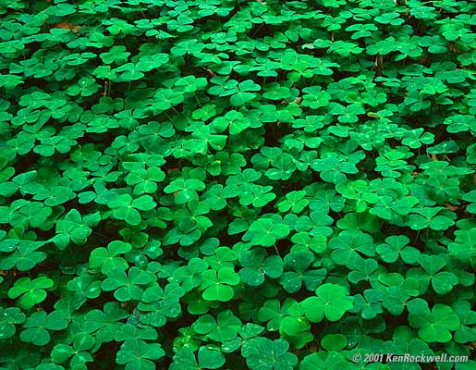
Chemical Mimics
The hairy wild potato gives out a chemical that mimics the alarm call of aphids, so they avoid the plant.
Some clovers are able to make a chemical that mimics oestrogen, thus causing fertility problems in herbivores that might eat them.

Slide 34
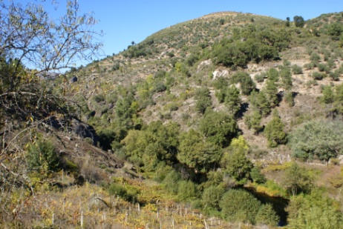
Sending Warnings
Scientists have discovered that willows and alders can communicate by airborne chemical cues.
In response to attack by insects, trees develop insect resistant chemicals.
If one tree is attacked, trees a fair way away respond by developing the insect-resistant chemical as well.

Slide 35
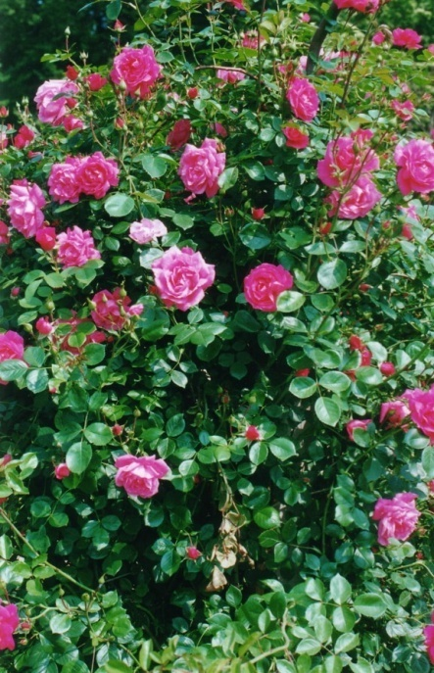
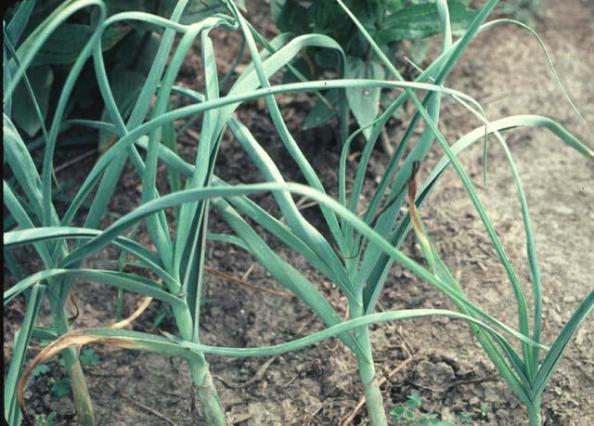
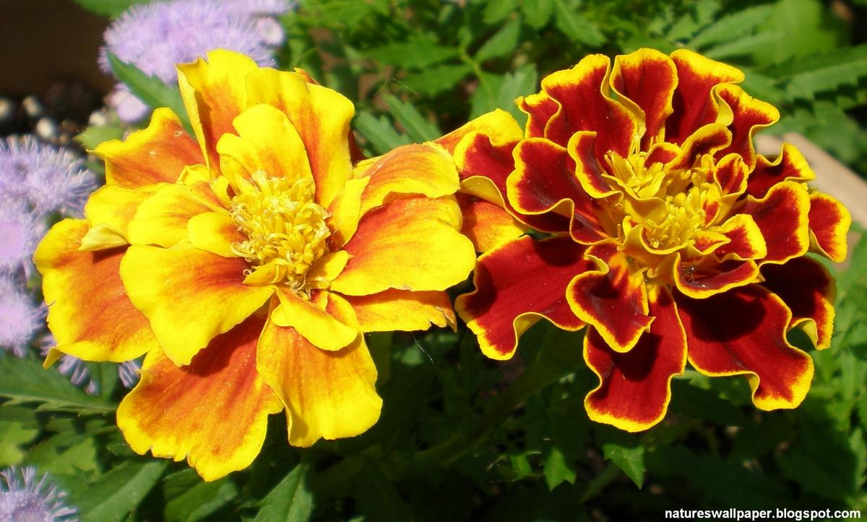
Companion Planting
Marigold roots secrete a chemical that kills nematodes.
This helps the plants growing nearby.
Garlic planted in rose gardens is thought to keep aphids away.

